Slide 1
Superstore Sales Analysis Using SQL Server & Power BI
This project presents an end-to-end data analysis of the Superstore dataset. Starting with raw data in SQL Server, the data was cleaned, duplicates were removed, and structured views were built. The final results were visualized through an interactive Power BI dashboard covering sales performance, customer behavior, and product insights.
Ali Shemes

Slide 2
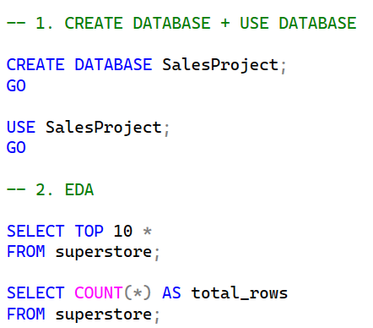
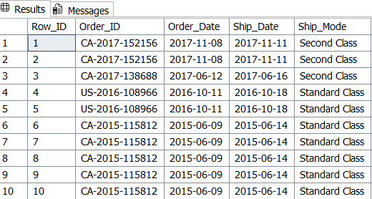
Database Setup & Exploratory Data Analysis
💻
📊 Output
Chart / Table / Result
Create Database & EDA
Create a new database called SalesProject and switch to it to start working.
Preview the data by selecting the first 10 rows to understand the structure and columns of the dataset.
Count total rows to check the size of the dataset before any cleaning or processing.

Slide 3
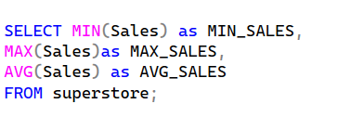

Database Setup & Exploratory Data Analysis
💻
📊 Output
Chart / Table / Result
Analyzed sales distribution using summary statistics (Min, Max, Average, and Standard Deviation) to gain insights into overall sales behavior

Slide 4
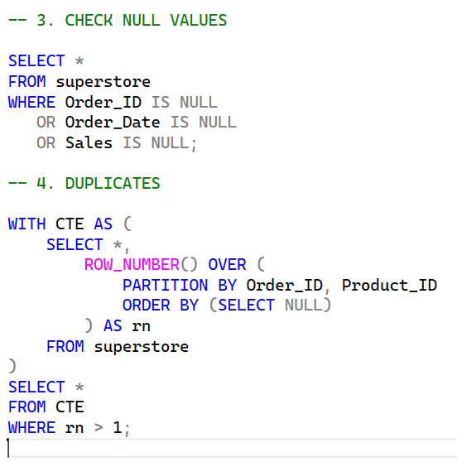

NULL Values Check & Duplicate Detection
💻
📊 Output
Chart / Table / Result
Checking for NULL values in the most critical columns to ensure data completeness.
Then using CTE with ROW_NUMBER() to detect any duplicate records based on Order_ID and Product_ID combination.

Slide 5
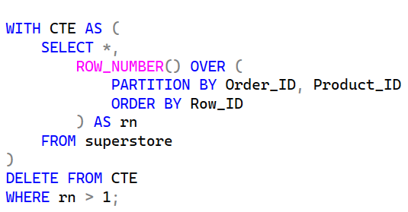
Data Cleaning — Remove Duplicates
💻
📊 Output
Chart / Table / Result
Using CTE with ROW_NUMBER() to identify duplicate records, keeping only the first occurrence ordered by Row_ID. Then deleting all rows where the row number is greater than 1 to ensure each Order_ID and Product_ID combination appears only once.

Slide 6
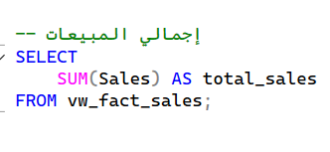

Total Sales Analysis
💻
📊 Output
Chart / Table / Result
Calculating the total revenue generated across all orders and years using SUM() aggregation on the fact view.

Slide 7
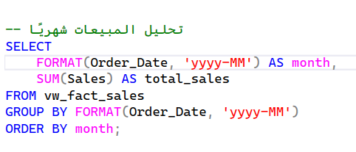
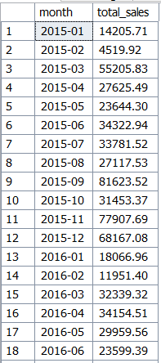
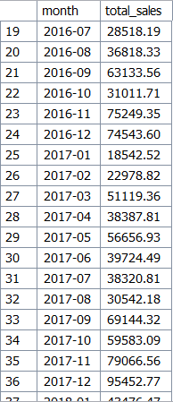
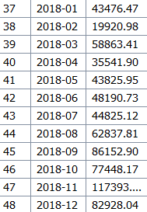
Monthly Sales Analysis
💻
📊 Output
Chart / Table / Result
Grouping sales by month using FORMAT() to extract the year-month from the date, then aggregating total sales per month to identify seasonal trends and peak periods.

Slide 8
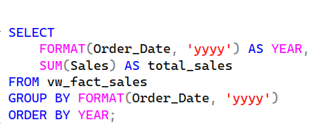
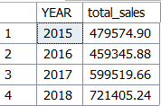
Yearly Sales Analysis
💻
📊 Output
Chart / Table / Result
Grouping sales by year using FORMAT() to extract the year from the date, then aggregating total sales per year to track revenue growth over time.

Slide 9
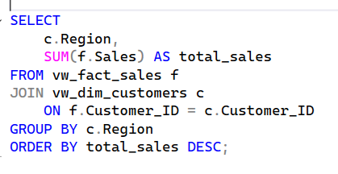
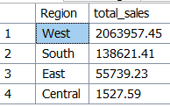
Regional Sales Analysis
💻
📊 Output
Chart / Table / Result
Joining the fact view with the customers dimension view to get the region for each order, then grouping and aggregating sales by region to identify the highest performing areas.

Slide 10
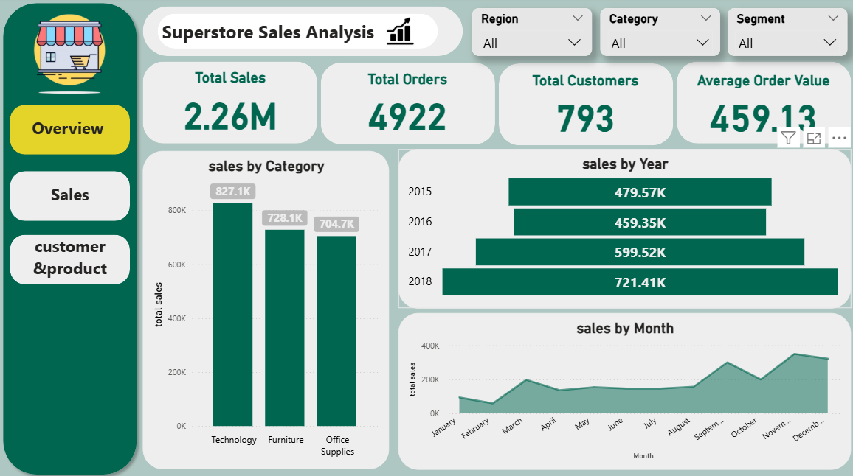
Dashboard Overview
📊
Insert Dashboard Screenshot Here
(Right-click → Format Picture → Replace image)

Slide 11
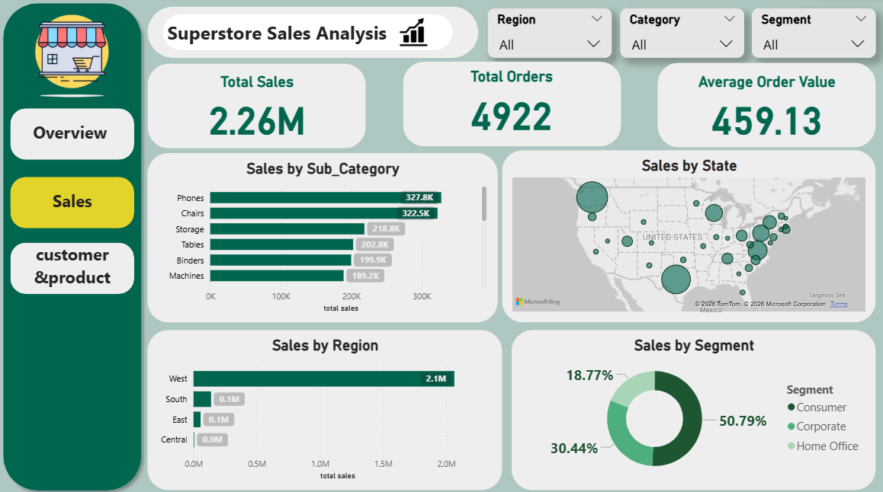
Dashboard Sales
📊
Insert Dashboard Screenshot Here
(Right-click → Format Picture → Replace image)

Slide 12
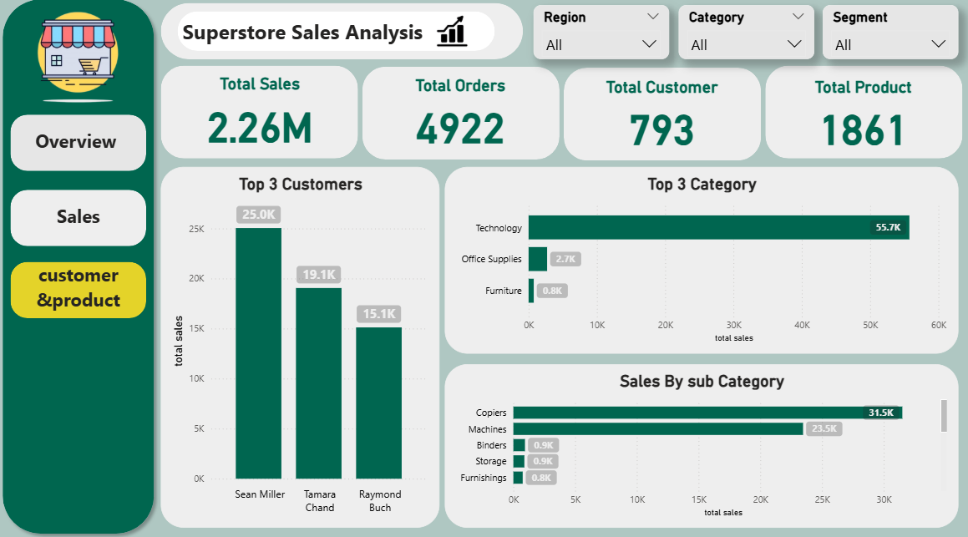
Dashboard Customer&Product
📊
Insert Dashboard Screenshot Here
(Right-click → Format Picture → Replace image)

Slide 13
Conclusion
Summary
This project performed an end-to-end analysis of the Superstore dataset using SQL Server and Power BI. The data was cleaned, duplicates were removed, and structured views were built following a Star Schema. Business analysis queries were used to extract key insights, which were then visualized through an interactive Power BI dashboard.
Recommendations
Focus marketing efforts on the West region as it generates the highest revenue
Invest more in Technology category as it is the top performing category
Prepare for peak seasons in November & December to maximize sales
Investigate the low performance in the South region to identify growth opportunities
Target Consumer segment as it represents over 50% of total sales

